Slide 1
Memory network
Hoang Le

Slide 2
Outline
1. Notion of NN with Ext Memory
Why and How they came up with the idea of using external memory, brief introduction
2. Foundational ideas
Introduce important papers about Memory Network
3. Use cases
Some practical usages for QA problem

Slide 3
Notion of Neural Net with External Memory
1

Slide 4

Human-like derivation
Human has memory to manipulate short- and long-term information
As facing a problem, people tend to revisit the “experience” to solve
”Experience” comes from what is taught or experienced before
“Short-term memory” or “working memory” is quantified by the limited number of ”chunks” information that can be readily recalled (Miller, 1956)
The idea of Memory Network is similar to “short-term memory” or “working memory” in psycology

Slide 5
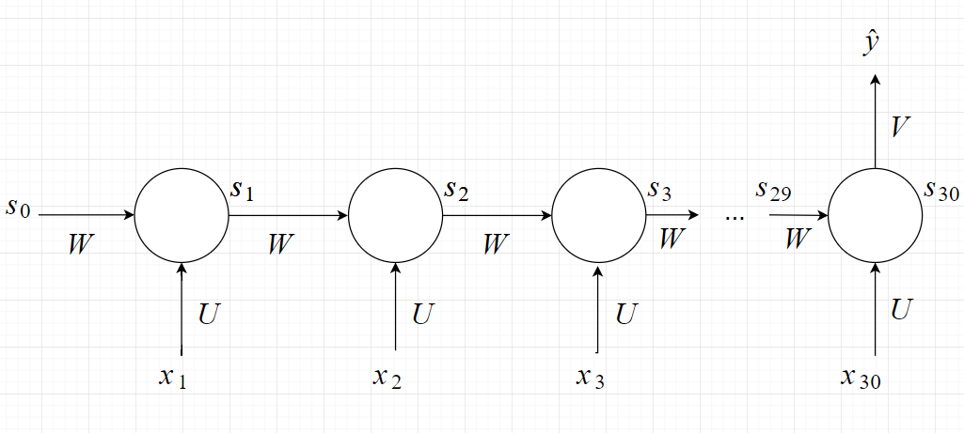
RNN, LSTM and Memory
RNN is used to deal with time-series data
RNN is capable of capturing information in few previous steps
However, RNN is lack of memorizing further steps (vanishing/exploding gradient)

Slide 6
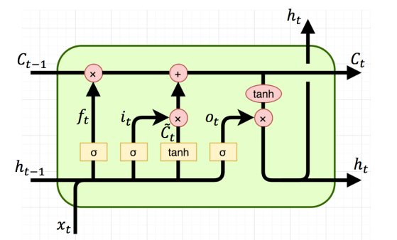
RNN, LSTM and Memory
LSTM alleviates by adding flow ”c” as “cell state”, selective forget, selective add and selective leak
Although LSTM has “cell state”, it is not considered as Memory Network because memory component and calculation are not separated

Slide 7
Foundational ideas/papers
2

Slide 8
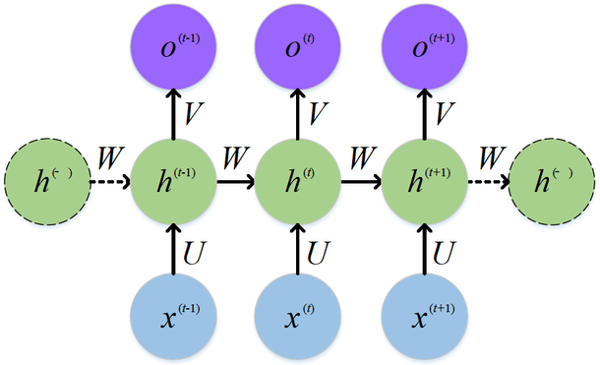
Basic architecture of Memory-augumented NN
Memory bank
Note that: Each step in this model is not each step as reading tokens in sentence.
The notion of step is varied regarding different settings

Slide 9
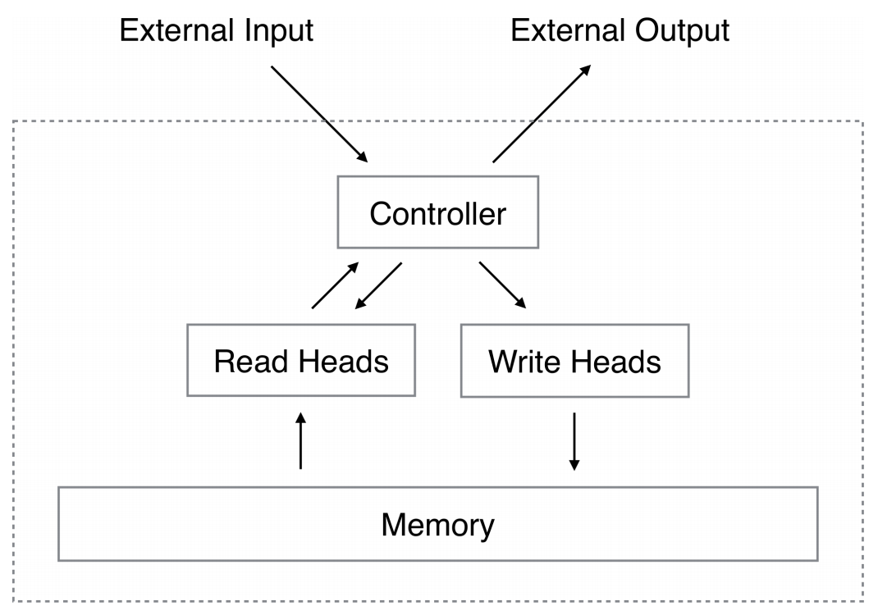
Neural Turing Machine
2.1
Graves et. al., 2014
Neural Turing Machine composes of 2 basic components:
Controller
Memory bank
- Memory bank is place to back up information ; may be a tensor
- Controller is a neural network that interacts with external information and internal information.

Slide 10
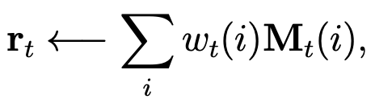
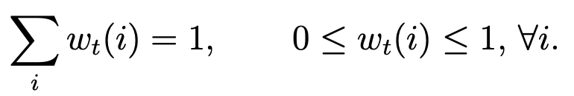
Neural Turing Machine
2.1
Reading mechanism
Let
M_{t} : the contents of the N × M memory matrix at time t ; memory matrix composes of N vectors, each vector is M elements
w_{t} : normalized weighting vector over N locations (rows)
r_{t}: read memory (dim-M vector)

Slide 11
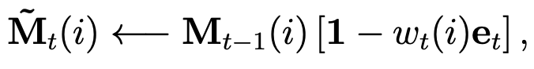
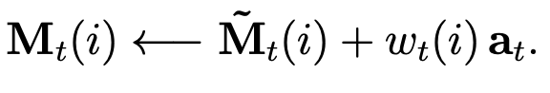
Neural Turing Machine
2.1
Writing mechanism
Writing mechanism is decomposed into 2 parts: erase and add
Let
M_{t} : N × M memory matrix at time t
w_{t} : normalized weighting vector over N locations (rows)
e_{t}: erase vector (dim N)
Erase part
Add part
Each row in matrix M_{t} is updated by
Each row in matrix M_{t} is updated by

Slide 12
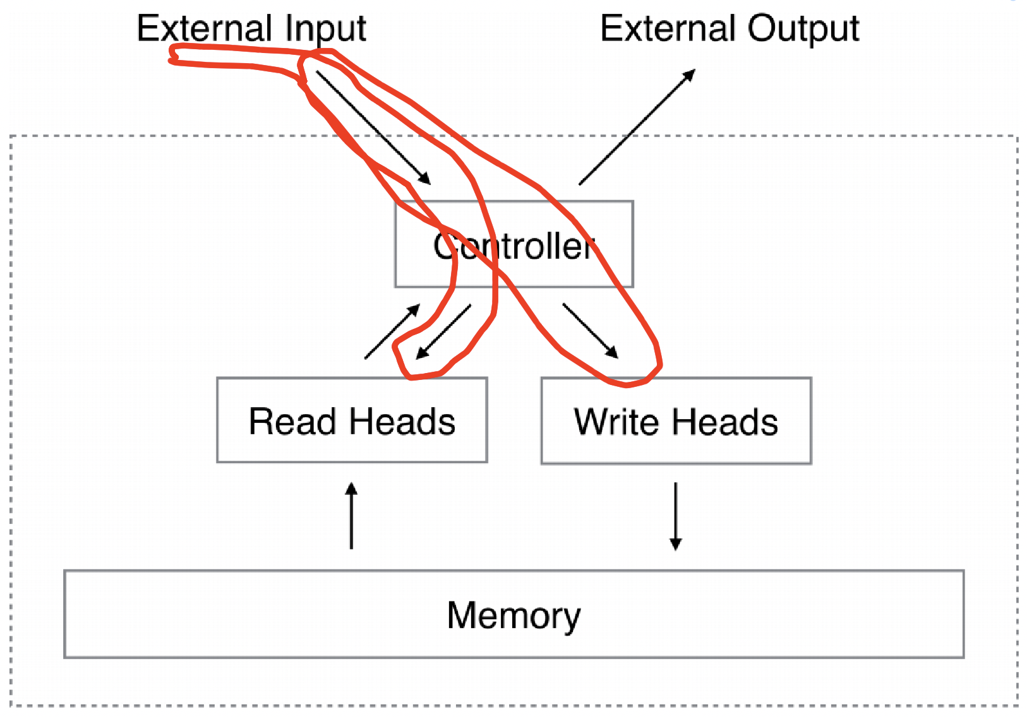
Neural Turing Machine
2.1
Addressing mechanism
Addressing mechanism aims determining normalized weighting vector w_{t}
It is based on 2 mechanisms: content-based addressing and location-based addressing
Content-based method attends locations similar (cosine similar) with external information
Location-based methods employ some mechanism to visit locations

Slide 13
Neural Turing Machine
2.1
Controller component
e_{t}, a_{t} and others vectors for Addressing
Reading, Writing,
Addressing

Slide 14
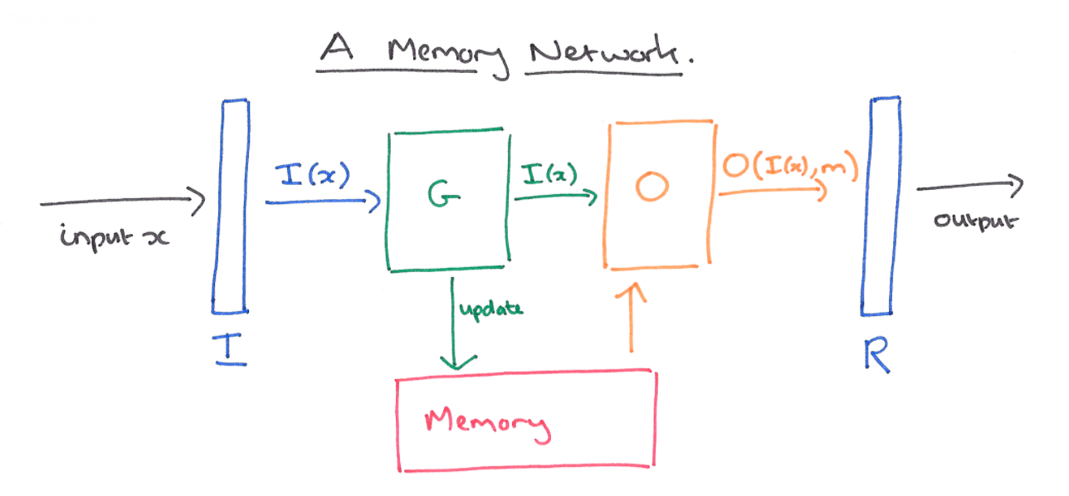
Memory Network
2.1
Jason et. al., 2015
Basically, Neural Turing Machine and Memory Network are quite similar
Neural Turing Machine
Memory Network

Slide 15
Memory Network
2.1
4 components:
I: Input feature map: convert external info to internal feature representation
G: Generalization: Update old memory
O: Output feature map: produce new output
R: Response: Convert output to response format
( I(.) and O(.) in the same space)

Slide 16
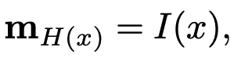
Memory Network
2.1
I component: can be anything: simple Linear function, standard pre-processing, e.g., parsing, coreference and entity resolution for text inputs
G component: Update one or many memory locations by output of component I ; similar to Reading, Writing and Addressing in NTM
O and R component: produce output and convert output to original space

Slide 17
Use cases
3

Slide 18
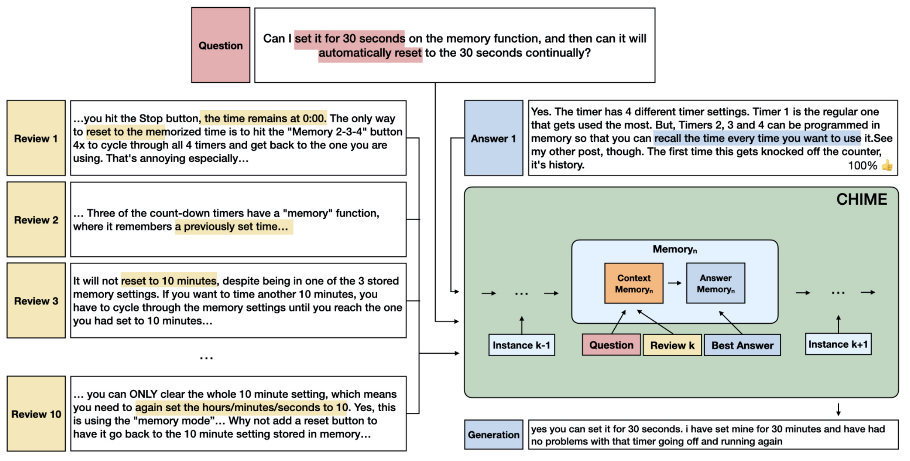
CHIME
3.1
Junru et. al., 2020
This model is born to deal with QA over multi-passages problem
Dataset used is AmazonQA: Given a list of reviews about a product, when a custommer asks about that product, model uses reviews to answer that question

Slide 19
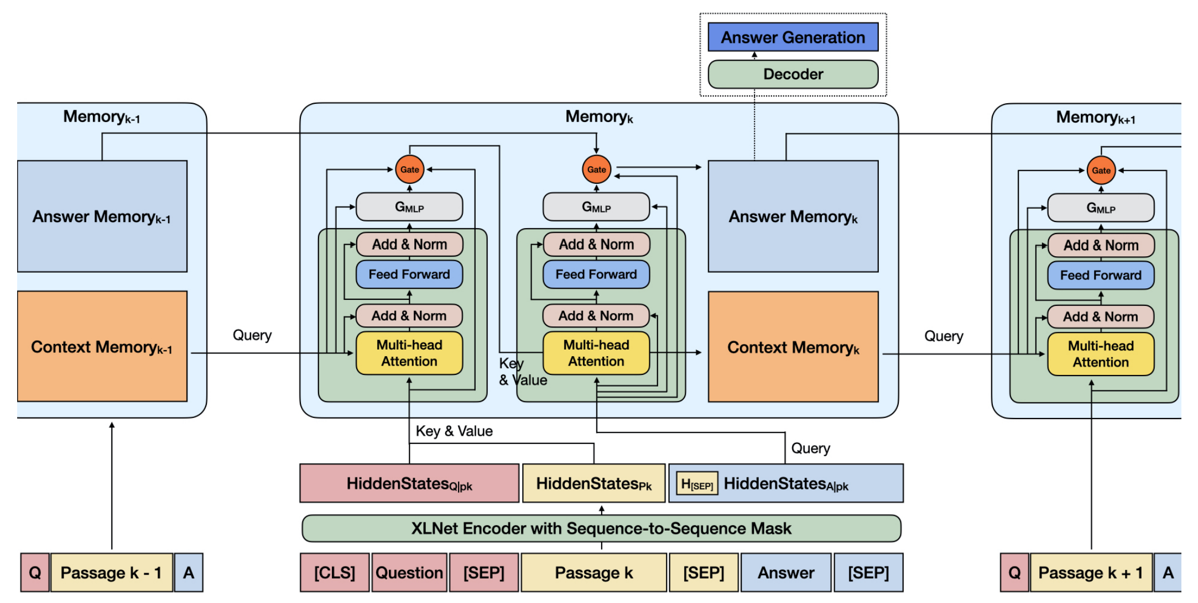
CHIME
3.1
Model architecture

Slide 20
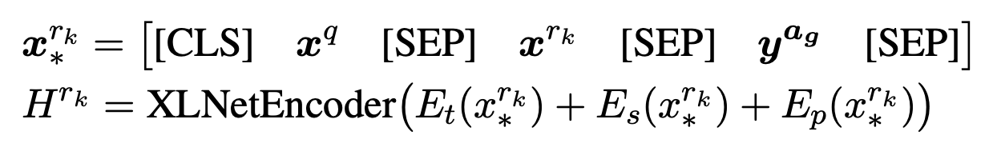
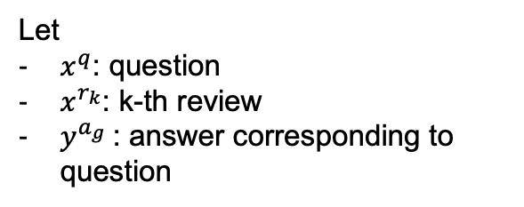
CHIME
3.1
Let
$x^{q}$: question
$x^{r_{k}}$: k-th review
$y^{a_{g}}$: answer corresponding to question
1. Encode using XLNet
Notes:
Et, Es, Ep are token embedding, segment embedding and positional embedding

Slide 21
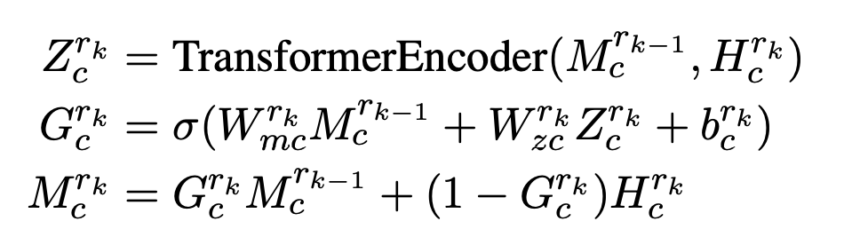
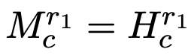
CHIME
3.1
2. Reasoning with Transformer and Memory
Let:
M_{c}: context memory
H_{c}: concatenated embedded question and context
Context memory is initialized by hidden state after reading first passage:
Memory update happens not at single cell but entire memory instead

Slide 22
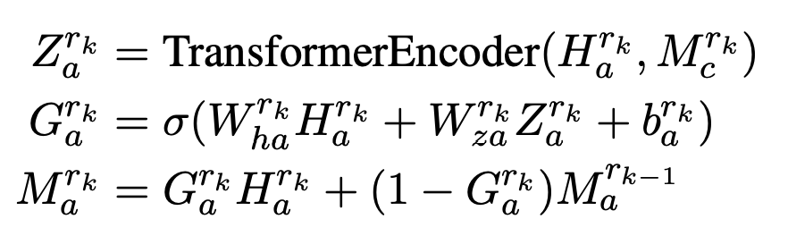
CHIME
3.1
3. Inferring answer
Let:
M_{a}: answer memory
H_{a}: embedded answer

Slide 23
CHIME
3.1
Gating: control how much is overriden in each memory cell
Writing step in Neural Turing Machine
Notion of step: each step, model deals with each passage.

Slide 24
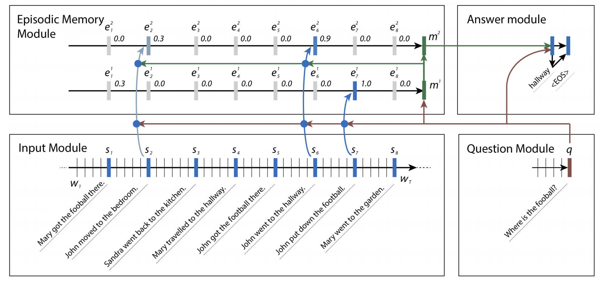
DMN
3.2
Kumar et. al., 2015
DMN employs Memory Network in different fashion to also deal with QA problem.

Slide 25
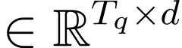
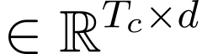
DMN
3.2
Kumar et. al., 2015
1. Encode context and question
Let
T_{q}: sequence length of question
T_{c}: max number of sentences in context
Question is encoded by GRU, obtain q
Context is passed through another GRU, embedding vector of EOS of each sentence in context is concatenated, obtain c

Slide 26
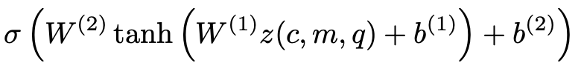
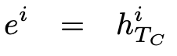
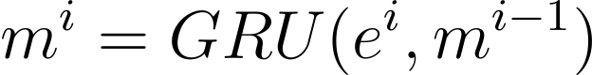
DMN
3.2
2. Reasoning with Episodic Memory module
where
Let
T_{M}: total number of passes
T_{q}: sequence length of question
T_{c}: max number of sentences in context
q: embedded question ;
c: embedded context ;
g =
z(c, m, q) =
m₀ = q
for i in range(1, TM):
for t in range(Tc):

Slide 27
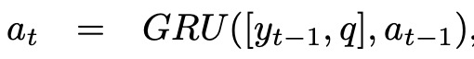
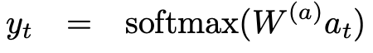
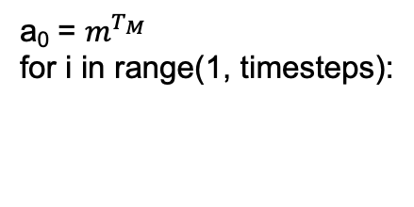
DMN
3.2
3. Inferring answer
Having final memory cell $m^{T_{M}}$, answer is inferred as follow:
a₀ = $m^{T_{M}}$
for i in range(1, timesteps):
Notion of step: step in this setting is pass ; the number of passes is hyperparameter

Slide 28
Conclusion
Introduction of Memory Network: kind of NN using external memory
Foundational papers and ideas
Some practical usecases

Slide 29
Thank you

